Slide 1

MINI-TOOL KIT

Slide 2
Mini tool kit is an educational project to convert various images into other forms namely JPEG,PNG,WEBP etc.
Here we can convert images into JPEG,PNG within seconds.
We can change photo to PNG,PNG to TIFF,JPEG to TIFF etc.
This is to ensure that the file size is small enough.
Some file formats fits the digital needs better than others being lighter and faster to upload.

Slide 3
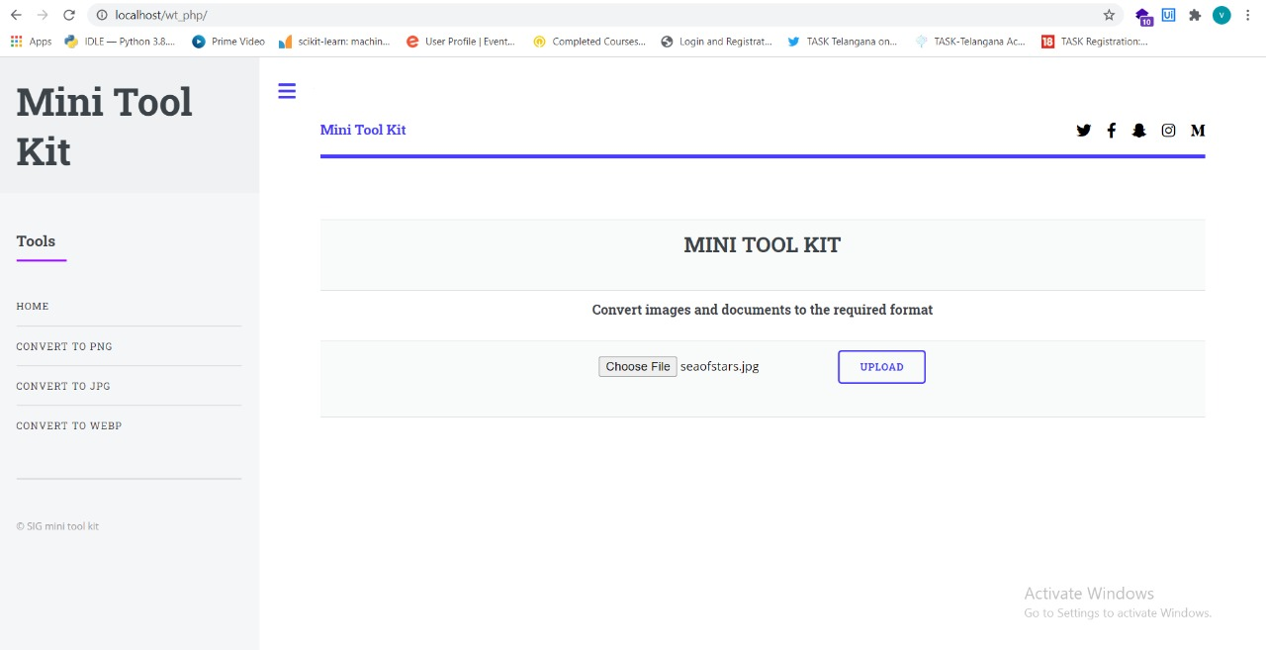

Slide 4
